Slide 1

GlobalMissionsData GMDeputation Data Structure
11 Sept 2020

Slide 2
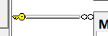
Data Structure
M37_Accom_Appoint
Accom_Use_ID
M33_AccomID
U01_UserID_Missionary
Start_Date_Time
End_Date_Time
Accom_Use_Notes
Missionary_Notes
Missionary_Rating
Accom_Rating
M31_Church_Service_times
M30_ChurchID
Day_of_week (master)
Service_Time
Service_Type (master)
Preference_level
Notes
M30_Church
ChurchID
ChurchName
Address
Lat
Long
M05_SectionID
Phone
EmailID
Website
M31_ChurchServiceTimes
M30_ChurchID
Weekday (master)
Time
RegularYN
Pref_Level
Attributes give general properties to users and churches to give richer means of creating connections
Relationships may be better with separate table (e.g. spouse), here is generalized
Languages according to ISO 639-3 to be included in attributes as L_[zzz], where zzz is the language code
M45_Appointment
AppointmentID
U01_UserID_Missionary
EventDateTime
Description
EntryDate
U01_UserID_EntryBy
M30_ChurchID
PIM_Amt
Offering
Notes
U01_User
UserID
M10_UserTypeID
FirstName
LastName
EmailID
Phone
Gender
Address
Lat
Long
M05_SectionID
CreateDate
ImageFile
EmailVerifiedYN
Status
M01_Country
CountryID
CountyName
M35_PastorChurch
U01_UserID
M30_ChurchID
RelationType
M02_State
StateID
StateName
StateCode
M02_Country
M33_Accommodations
M33_AccomID
M30_ChurchID
AccommType (master)
AccommNotes
M36_AttributeLinking
M07_AttributeID
U01_UserID
Attribute_Value
Notes
M03_StateDistrict
M02_StateID
M01_DistrictID
M06_Attributes
AttributeID
AttributeName
Attribute_Type (master)
AttributeNote
M40_MacroSched
MacroSchedID
U01_UserID?
Description
IsActive
EntryDate
U0_UserID_EntryBy
M04_District
DistrictID
DistrictName
DistrictCode
M41_MacroScheduleDistrict
M40_MacroSchedID
M04_DistrictID
U01_UserID?
StartDate
EndDate
M10_UserType
UserTypeID
UserType (master)
Priority
M05_Section
SectionID
SectionName
M04_DistrictID
U10_UserPermissions
M10_UserTypeID
M20_MenuID
U03_Relationships
U01_UserID
U01_UserID2
Relationship_Type (master)
U02_UserPassword
U01_UserID
Password
M20_Menus
MenuID
Menu

Slide 3
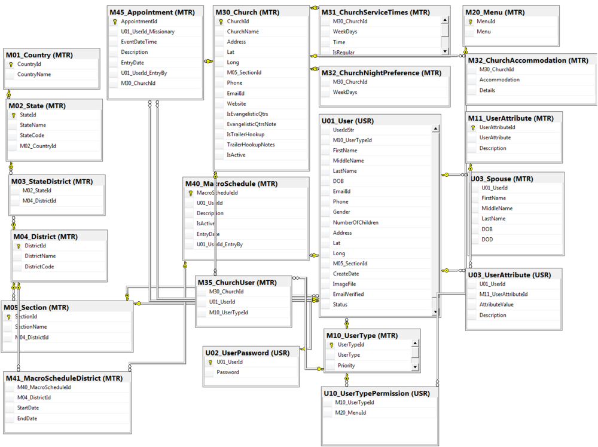
To Be Updated

Slide 4
Data Interfaces
M37_Accom_Appoint
Accom_Use_ID
M33_AccomID
U01_UserID_Missionary
Start_Date_Time
End_Date_Time
Accom_Use_Notes
Missionary_Notes
Missionary_Rating
Accom_Rating
M31_Church_Service_times
M30_ChurchID
Day_of_week (master)
Service_Time
Service_Type (master)
Preference_level
Notes
M30_Church
ChurchID
ChurchName
Address
Lat
Long
M05_SectionID
Phone
EmailID
Website
M31_ChurchServiceTimes
M30_ChurchID
Weekday (master)
Time
RegularYN
Pref_Level
Main interface is to UPCI HQ
User Table (Global missions)
Missionaries
Macro Schedule
DGMDs, DSs
User Table (NAM)
Pastors
Churches
Districts
M45_Appointment
AppointmentID
U01_UserID_Missionary
EventDateTime
Description
EntryDate
U01_UserID_EntryBy
M30_ChurchID
PIM_Amt
Offering
Notes
U01_User
UserID
M10_UserTypeID
FirstName
LastName
EmailID
Phone
Gender
Address
Lat
Long
M05_SectionID
CreateDate
ImageFile
EmailVerifiedYN
Status
M01_Country
CountryID
CountyName
M35_PastorChurch
U01_UserID
M30_ChurchID
RelationType
M02_State
StateID
StateName
StateCode
M02_Country
M33_Accommodations
M33_AccomID
M30_ChurchID
AccommType (master)
AccommNotes
M36_AttributeLinking
M07_AttributeID
U01_UserID
Attribute_Value
Notes
M03_StateDistrict
M02_StateID
M01_DistrictID
M06_Attributes
AttributeID
AttributeName
Attribute_Type (master)
AttributeNote
M40_MacroSched
MacroSchedID
U01_UserID?
Description
IsActive
EntryDate
U0_UserID_EntryBy
M04_District
DistrictID
DistrictName
DistrictCode
M41_MacroScheduleDistrict
M40_MacroSchedID
M04_DistrictID
U01_UserID?
StartDate
EndDate
M10_UserType
UserTypeID
UserType (master)
Priority
M05_Section
SectionID
SectionName
M04_DistrictID
U10_UserPermissions
M10_UserTypeID
M20_MenuID
U03_Relationships
U01_UserID
U01_UserID2
Relationship_Type (master)
U02_UserPassword
U01_UserID
Password
M20_Menus
MenuID
Menu

